Slide 1
Retail Sales and Customer Analytics
Presentation
9/18/2026

Slide 2
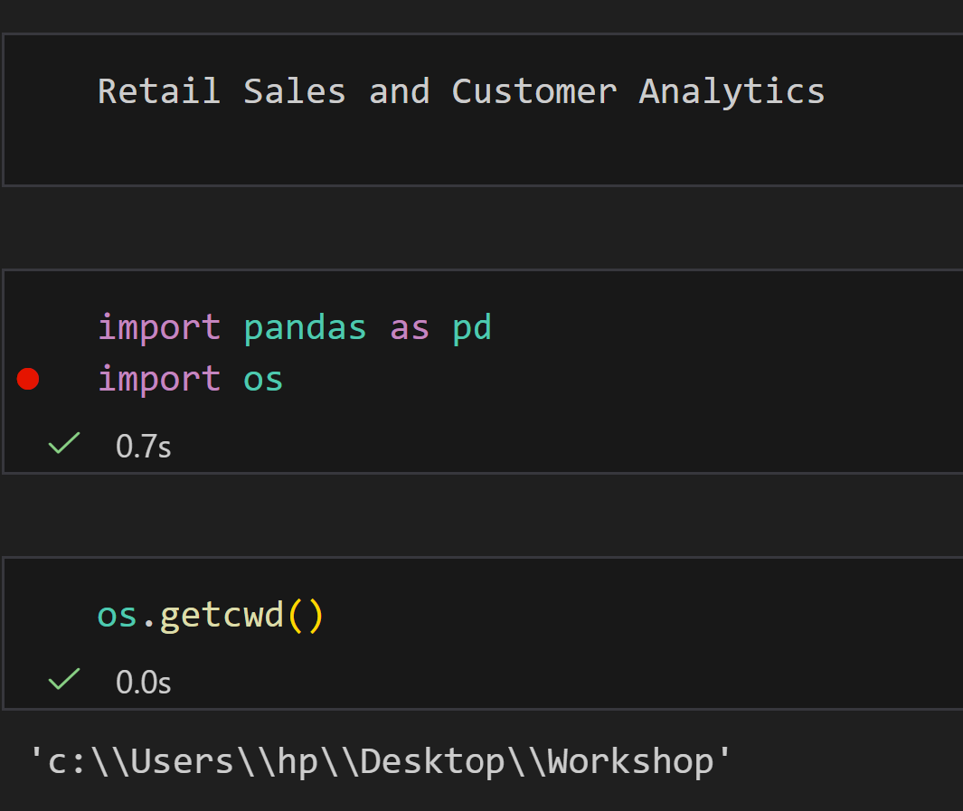
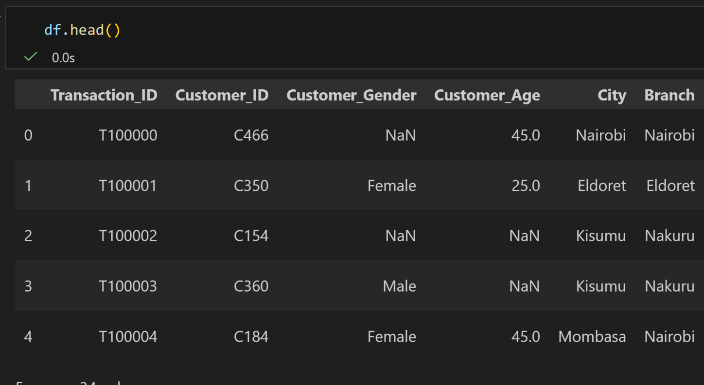
1.Import the retail sales dataset into R and verify that the dataset has been loaded successfully.

Slide 3
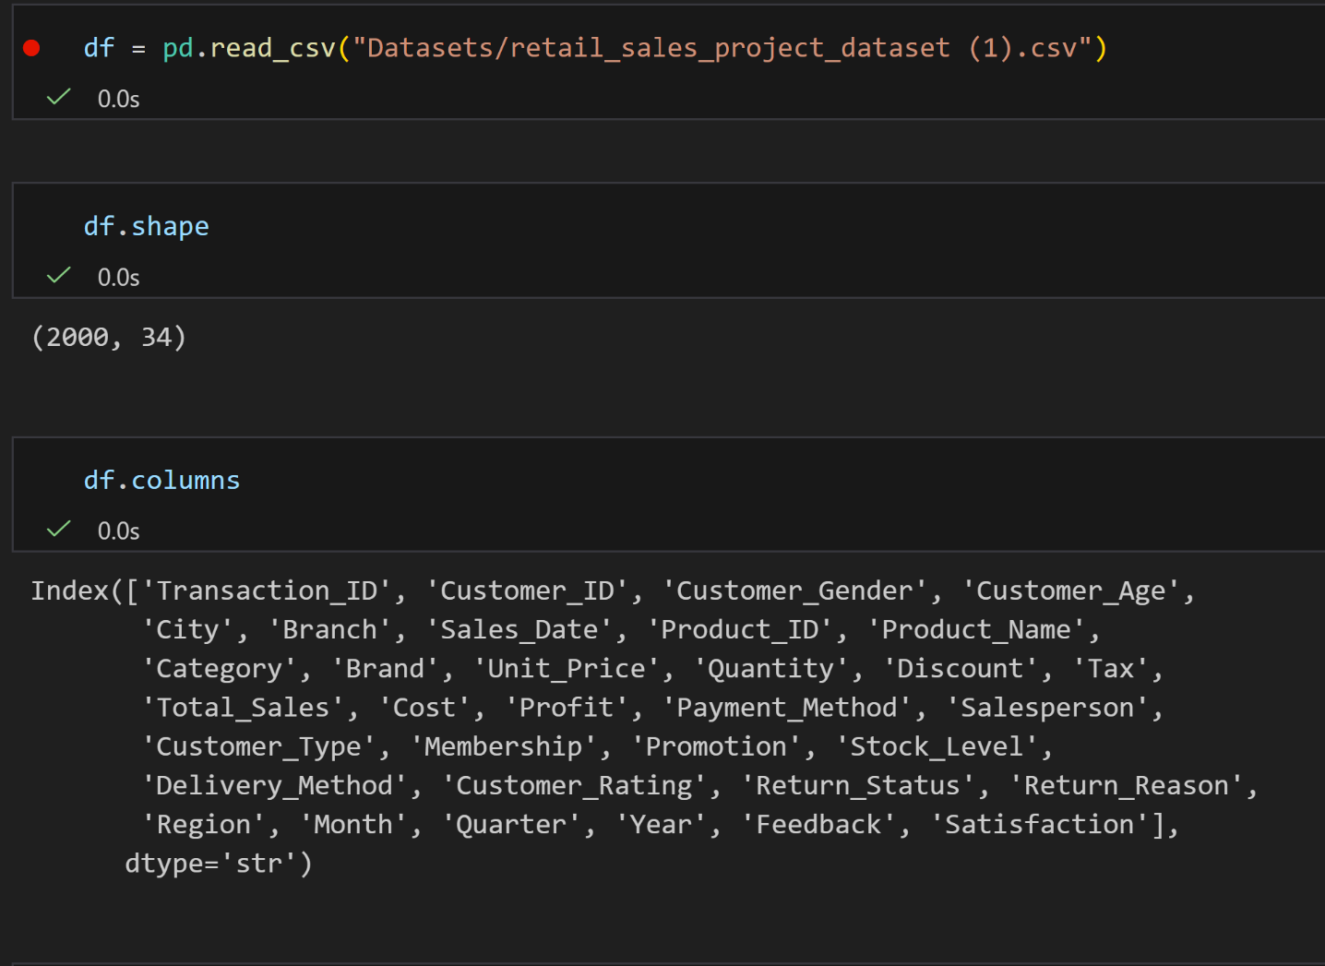
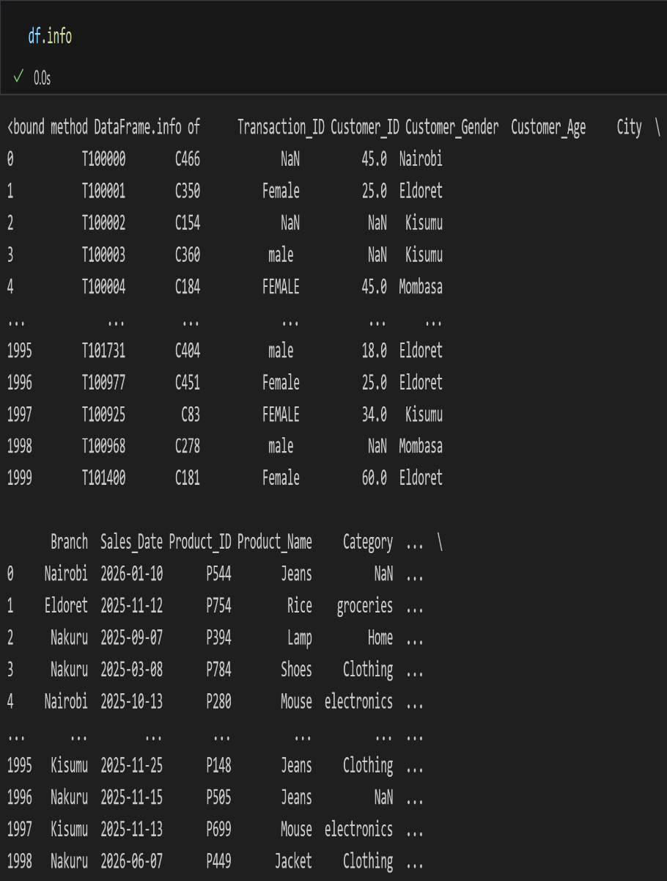
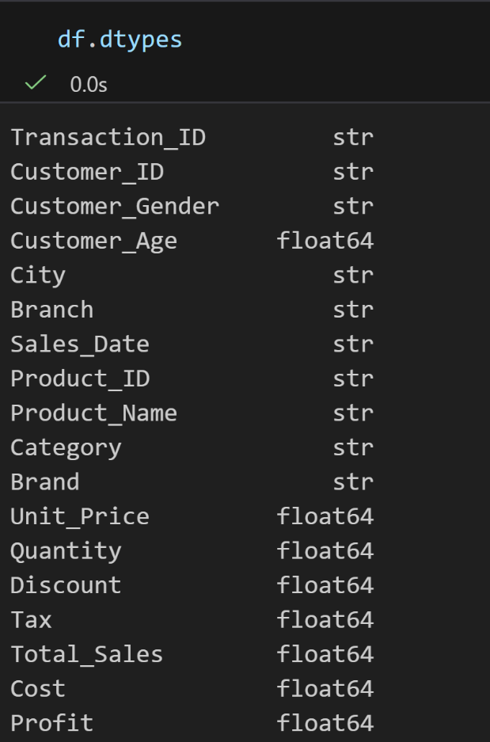
2. Examine the structure, dimensions, variables, and data types of the retail sales dataset.

Slide 4
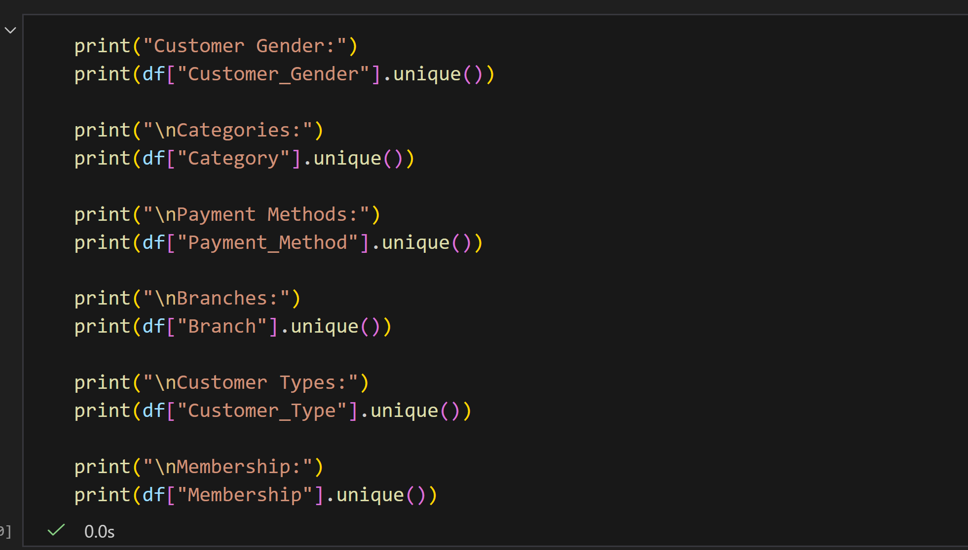
3. Explore the dataset to identify the different categories of variables available for analysis.

Slide 5
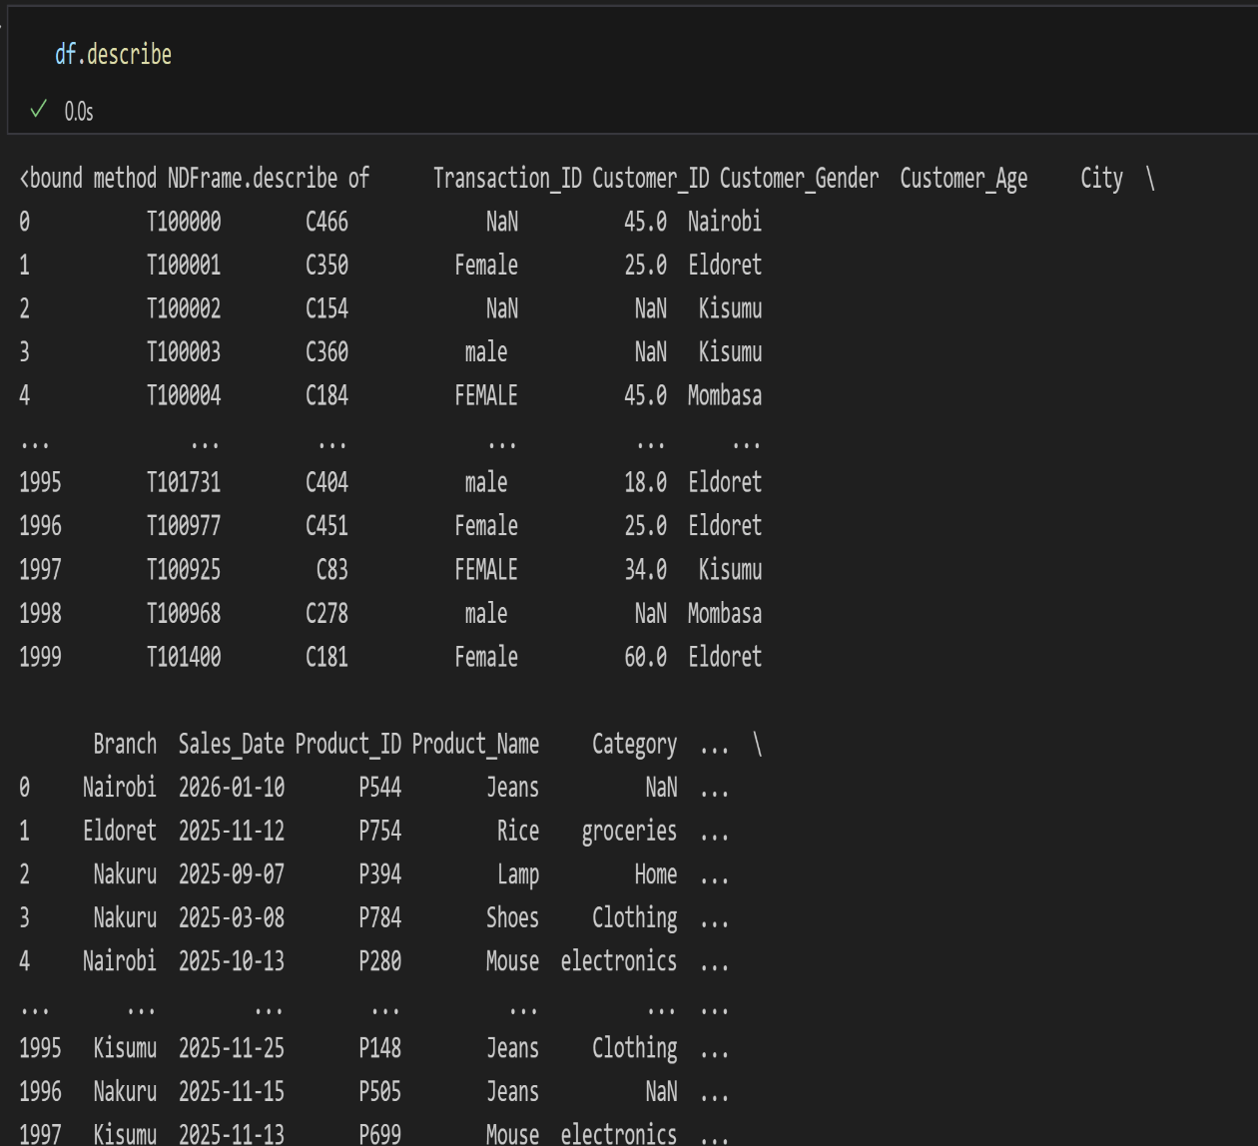
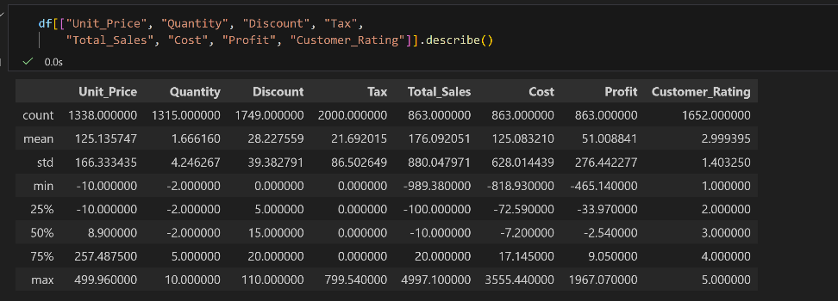
4. Produce descriptive summaries to gain an initial understanding of the dataset.

Slide 6
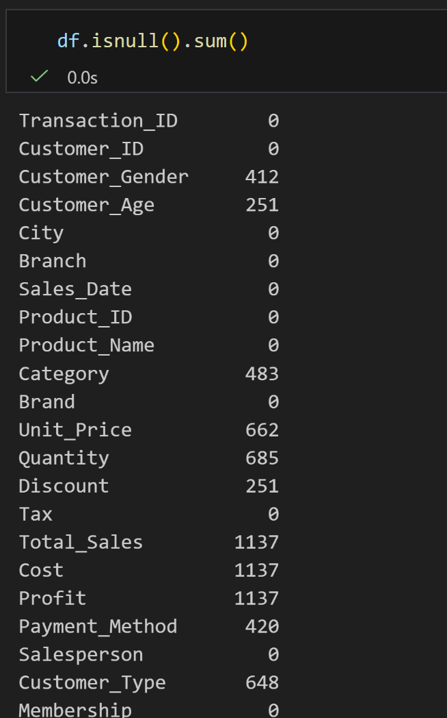
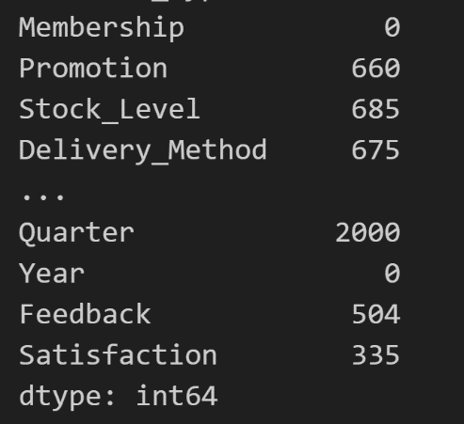
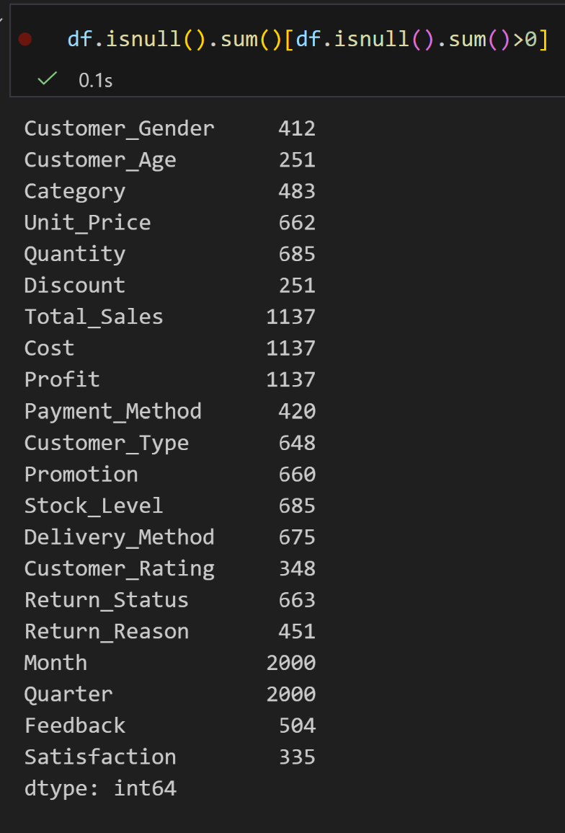
5. Clean and validate the retail sales dataset by identifying and correcting missing values using appropriate R techniques.

Slide 7
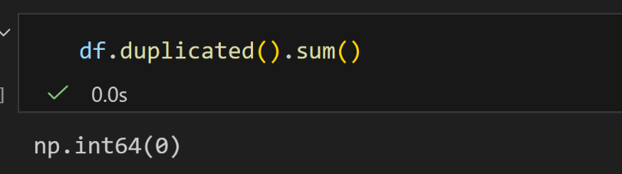
6. Identify, validate, and remove duplicate transaction records while preserving valid sales information.

Slide 8
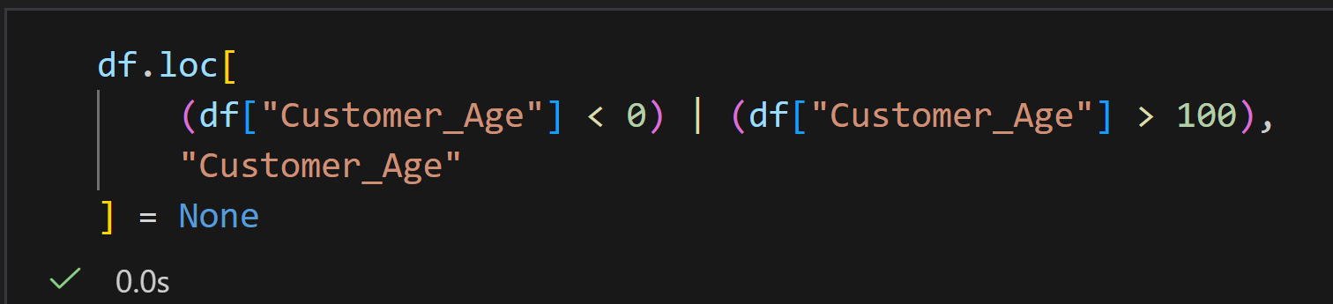
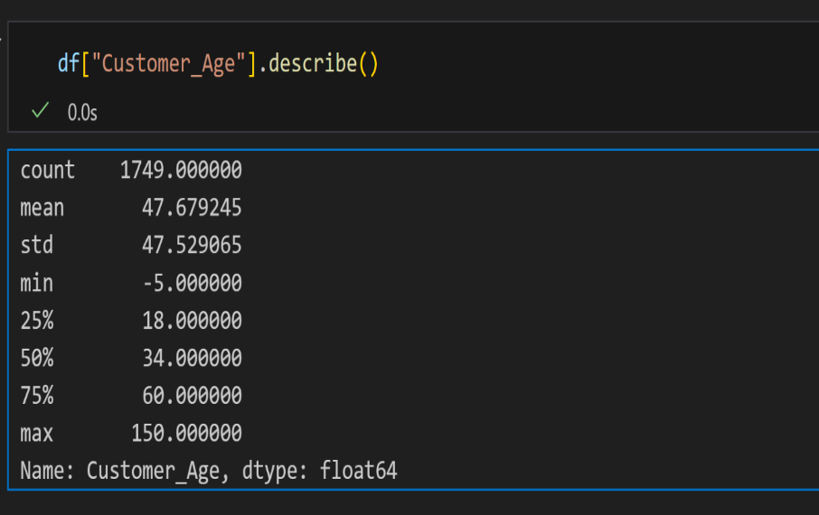
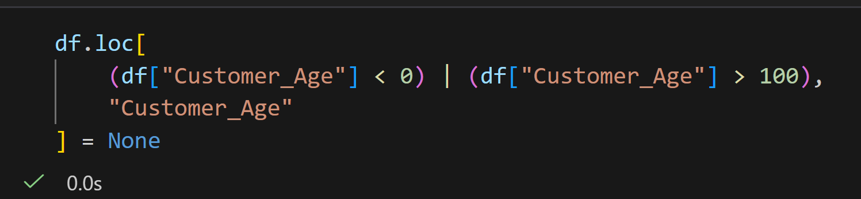
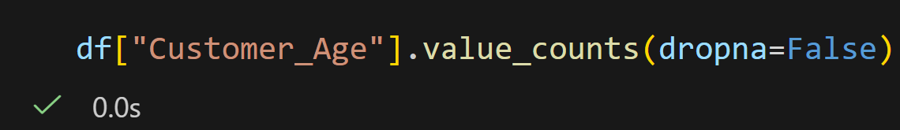
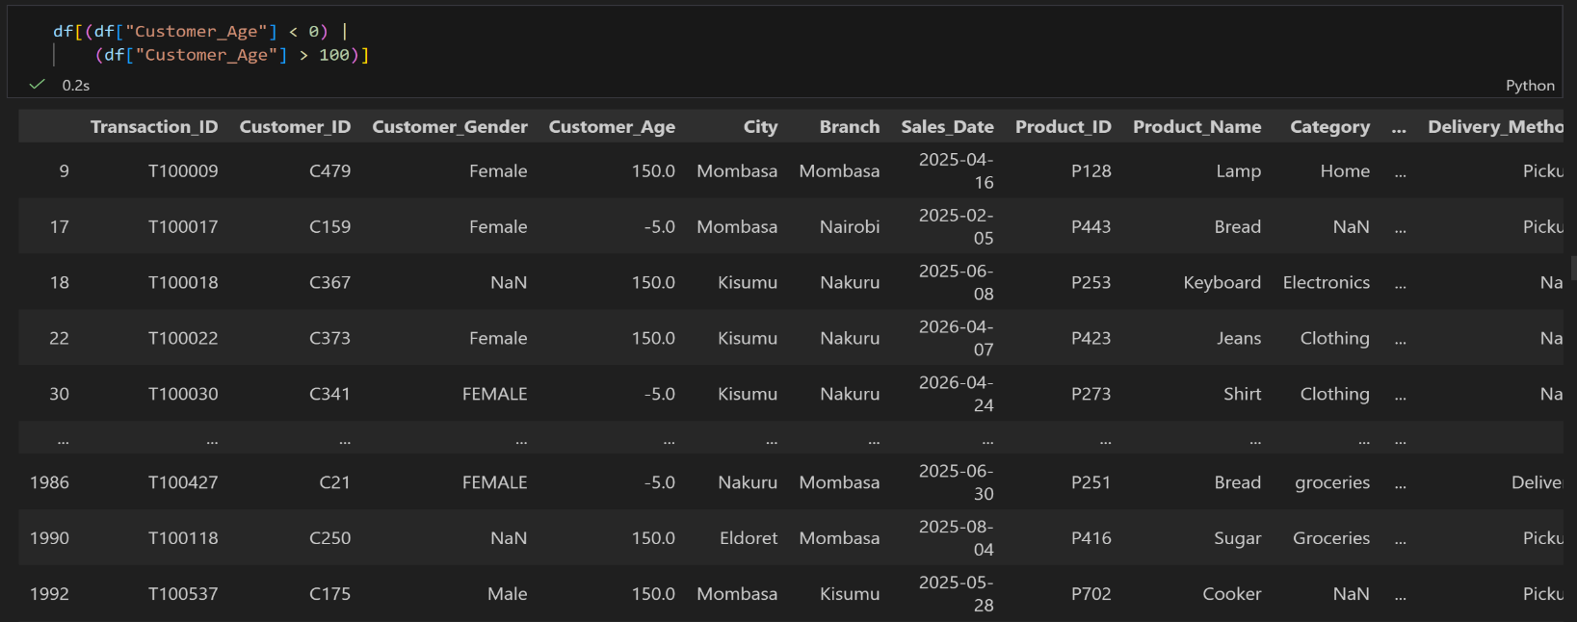
7. Validate customer demographic information by identifying invalid ages and inconsistent customer categories.

Slide 9
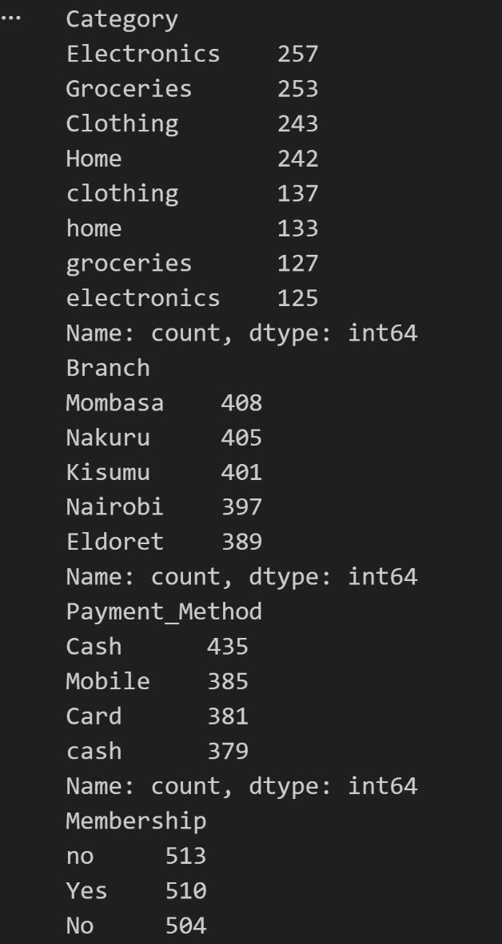
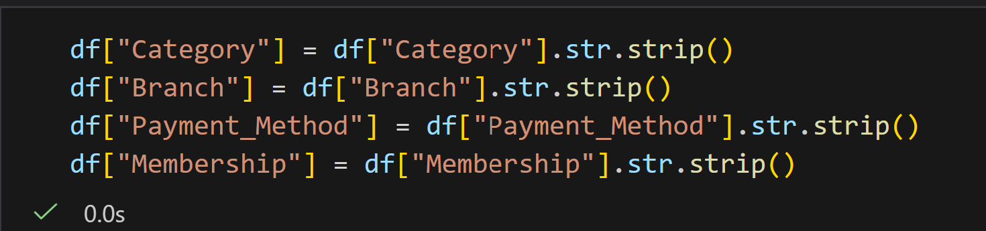
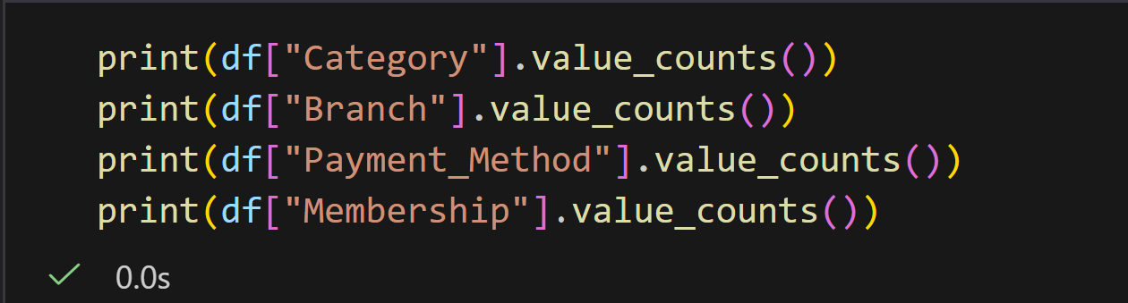
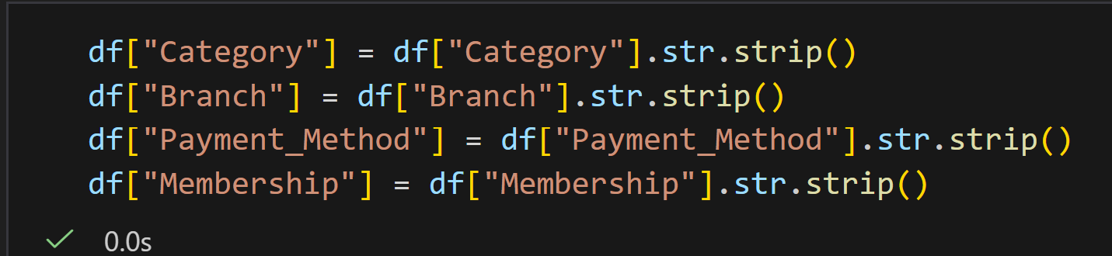
8. Standardize product categories, branch names, payment methods, and customer membership information.

Slide 10
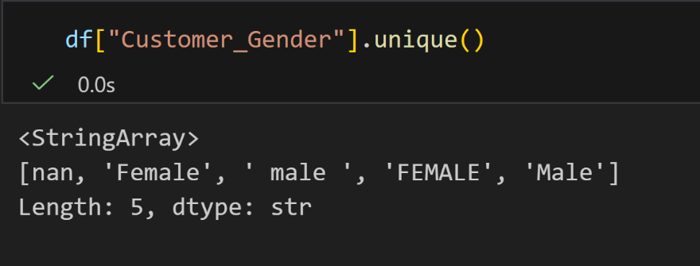
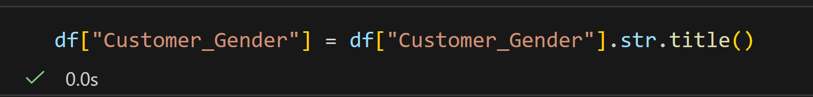
9. Detect and correct inconsistent text formatting including unnecessary spaces, mixed letter cases, and spelling inconsistencies.

Slide 11
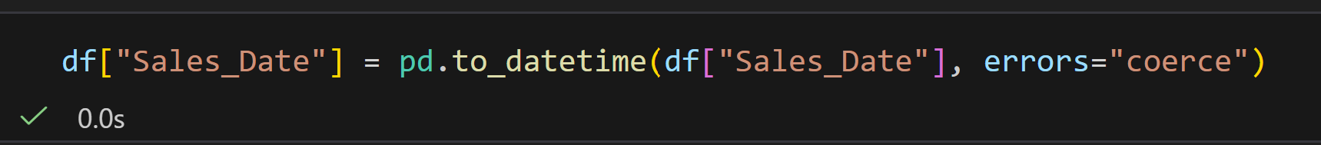
10. Convert variables into appropriate data types suitable for business analysis.

Slide 12
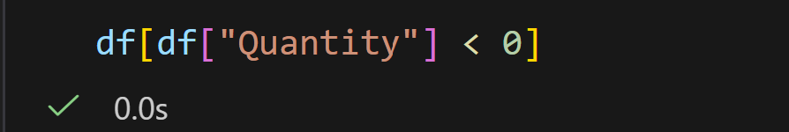
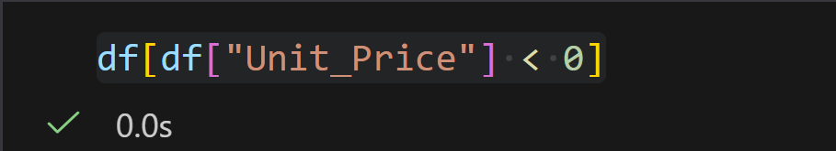
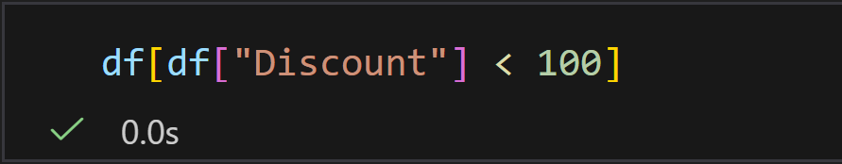
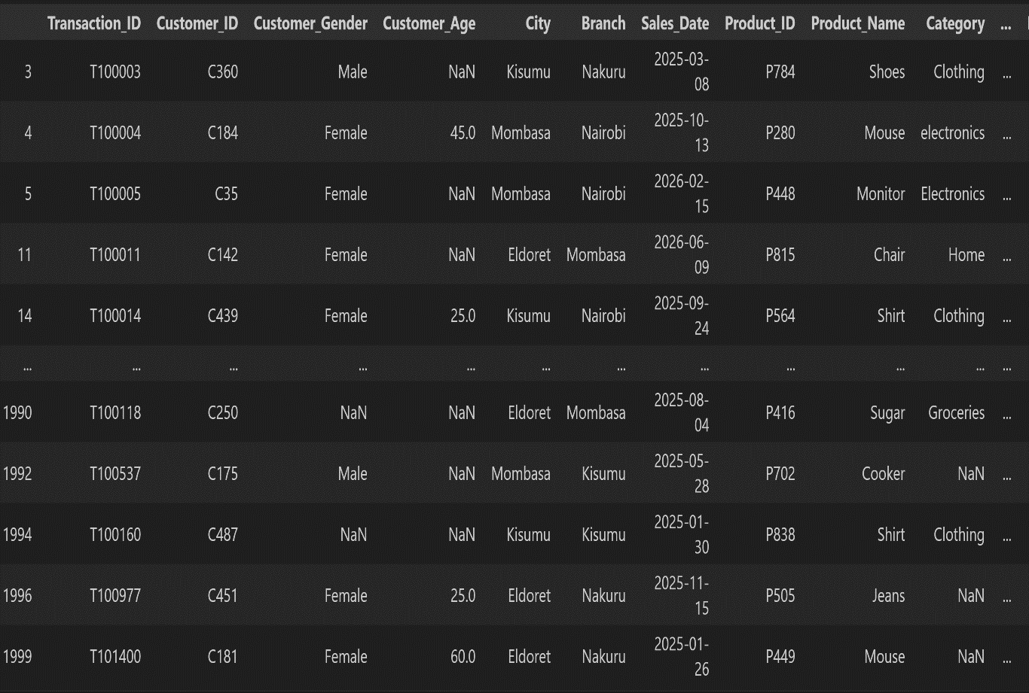
11. Identify and validate unrealistic numerical values such as negative quantities, incorrect discounts, invalid unit prices, and unrealistic profits.

Slide 13
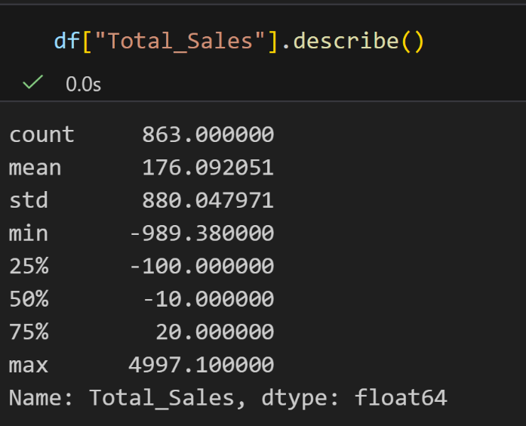
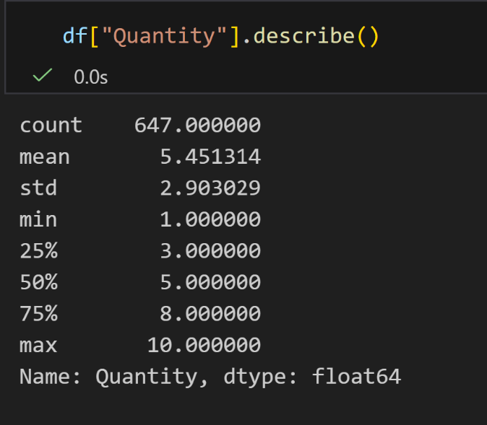
12. Detect and appropriately handle outliers in sales, profit, and quantity variables.

Slide 14
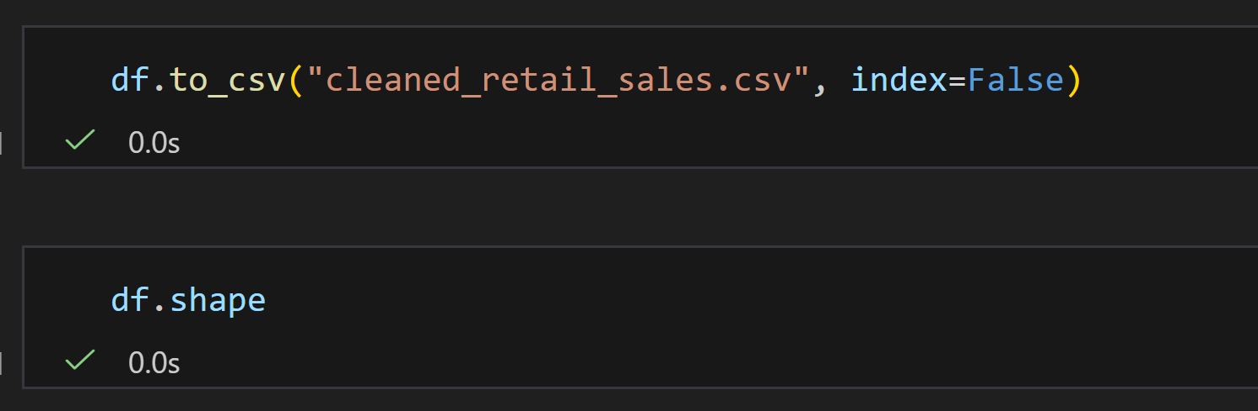
13. Produce a cleaned and validated retail sales dataset and export it as a new CSV file.

